Slide 1
Introduction to COVID-19 and the Complication of Blood Clots
Samuel Berkman, MD
Clinical Professor of Medicine
UCLA-Hematology/Oncology

Slide 2
Name of Disease
C O V I D - 19
COrona VIrus Disease described in 2019

Slide 3
Name of Disease
SARS-CoV2 = Severe acute respiratory syndrome- coronavirus II
COVID-19 & Blood Clots | www.stoptheclot.org

Slide 4
Definitions
Infectious diseases
Communicable disease
    Is it dangerous?
    Is it new?
    Route of infection?
Epidemic - pandemic
Containment
Mitigation

Slide 5
Common Abbreviations
PPE: Personal protective equipment
Respirator
EUA: Emergency Use Authorization
Ro: (pronounced R naught) Number each person infects
RCT: Randomized clinical trial
CT: Viral load

Slide 6
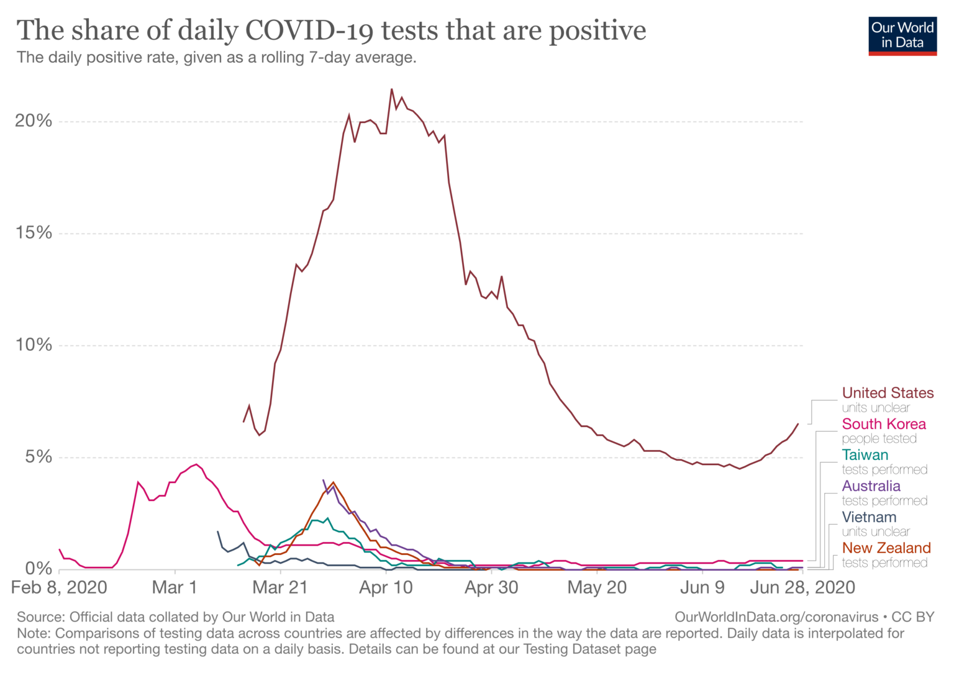
Flatten the Curve
To flatten the curve, the number of cases that a given infected individual causes (Ro) must be
below 1
Harvard Safra Center and Harvard Global Health Institute

Slide 7
Elsewhere
South Korea, Hong Kong, Taiwan: restricted entry to returning residents
Two-week quarantine
South Korea, Hong Kong: Airport testing
All positives to government facility
Australia: Military enforced isolation, as of March 27
Iceland: Run by scientists

Slide 8
Issues to iron out
Breakdown in tests
Lack of travel restrictions
Confusion about masks
Reversal of relationship between virus and economy

Slide 9
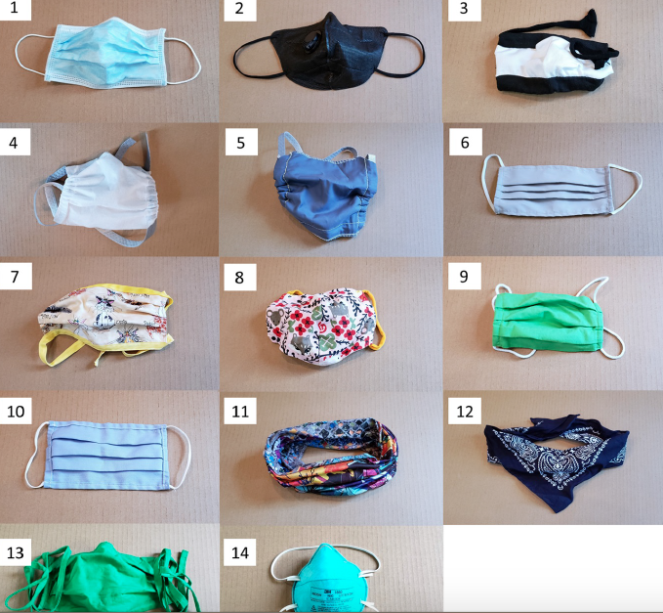
Different Masks
Fischer et al., Sci. Adv. 10.1126/sciadv.abd3083 (2020)

Slide 10
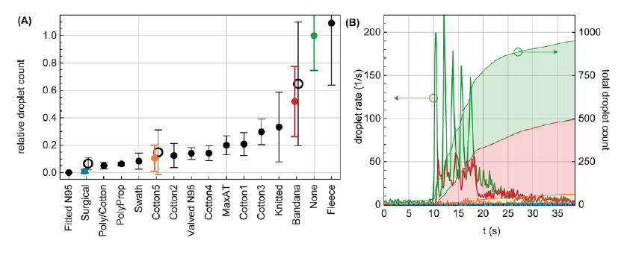
Effectiveness of mask
Fischer et al., Sci. Adv. 10.1126/sciadv.abd3083 (2020)

Slide 11
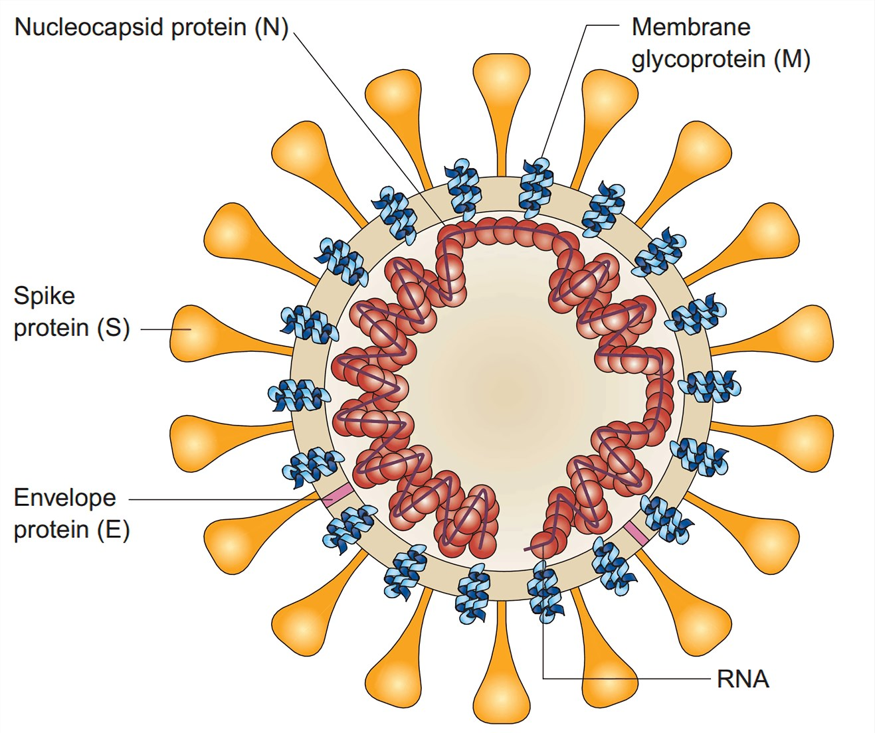
Diagnostic Tests for COVID-19
PCR Tests
Detect a piece of the viral RNA specific to SARS-CoV-2
Antigen Tests
Detect parts of the Nucleocapsid protein

Slide 12
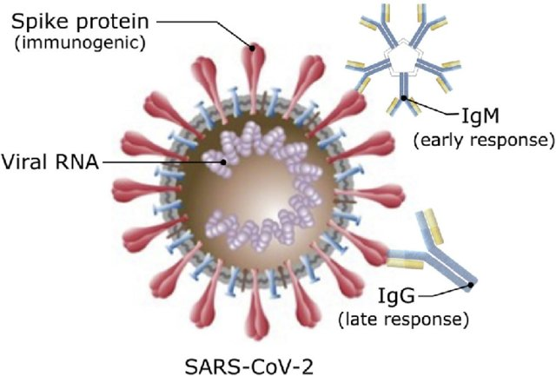
Covid-19 – Antibody Tests
Antibodies are proteins produced by the
immune system to protect against the virus.
Antibody tests detect the presence of IgM and IgG antibodies against SARS-CoV-2.
Confirm past infection
Confirm immunity - for how long?
Positive test – “Safety Ticket?”
Help open up the economy and get employees back to the workplace, in a safe way.

Slide 13
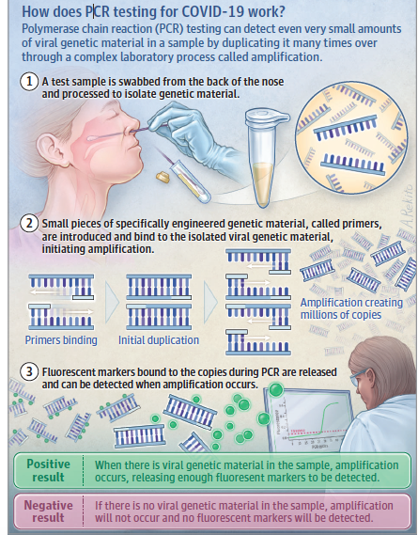
How Does PCR Testing for COVID-19 Work?

Slide 14
Why weren’t US labs prepared?
Reason #1. No experience with pandemic
The 2003 SARS outbreak in China, spread within months to two dozen countries in Europe, South America, North American and Asia
Cases in North America were @115 and all travel-related
Laboratories and manufacturers were not challenged for test development, nor was there a commercial incentive
Laboratory response completely centered at CDC

Slide 15
Why weren’t US labs prepared?
Reason #2. Regulatory Oversight
Problem: FDA enforced regulations that made it difficult on hospitals, private laboratories, and companies to manufacture diagnostic tests in an emergency
  Tests could not be created “in laboratory” or manufactured without direct oversight and approval of the FDA.
Solution: FDA modified some of the most restrictive regulations (3/1/2020)
  Allowed laboratories to develop high complexity molecular assays
  Must submit test validation to the FDA within 2 weeks of test launch and supply comparative data with local health departments.
Current approach: Emergency Use Authorization (EUA) has been granted to many manufacturers for COVID-19 related molecular assays
  First manufacturered test granted EUA status March 12, 2020

Slide 16
Testing Delays
Contaminated tests
Problems getting swabs and VTM
Now too many cases – hard to keep up with tests
COVID-19 & Blood Clots | www.stoptheclot.org

Slide 17
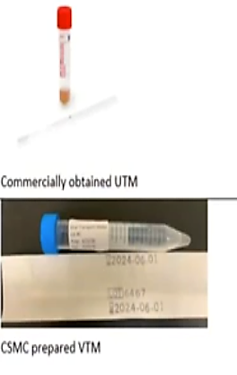
Potential Issues
Allocation for PCR kits
A*STAR assay kits have been ordered and currently available
Adequate supply of RNA extraction reagents for extraction instruments ongoing
Supply chain for flocked NP swabs and viral transport media
Greatest area of concern – no NP swabs in the supply chain
CSMC emergency manufactured VTM that may need to be used if orders are not filled by manufacturer
COVID-19 & Blood Clots | www.stoptheclot.org

Slide 18
Who to Test?
Symptomatic patients
Nursing homes
Hospitalized patients
Prior to immune modulating therapy
COVID-19 & Blood Clots | www.stoptheclot.org

Slide 19
Where to get tested?
Call your doctor
Hospital lab
Commercial lab
Local public health
Takes 15 min to several hours
Few false positives but considerable false negatives
COVID-19 & Blood Clots | www.stoptheclot.org

Slide 20
Symptoms in COVID Patients
Fever
Cough
Shortness of breath
Sore throat
Nasal congestion
Loss of taste and smell
Headaches
Diarrhea
COVID-19 & Blood Clots | www.stoptheclot.org

Slide 21
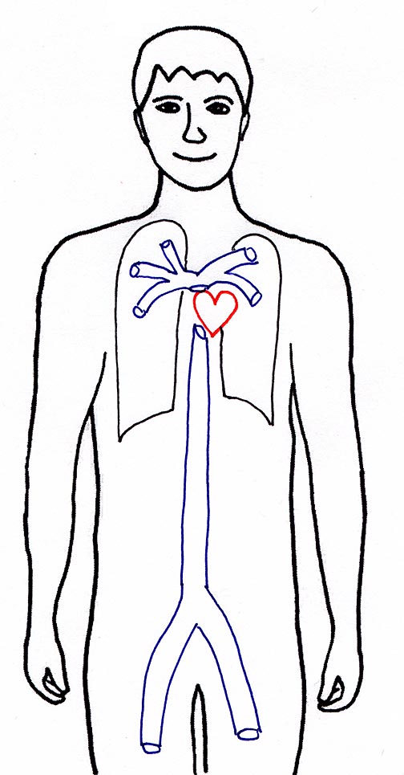
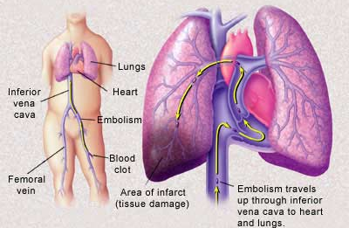
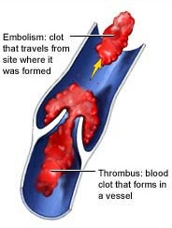
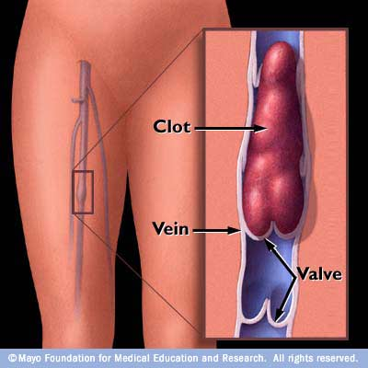
Deep Vein Thrombosis (DVT)
Pulmonary Embolism (PE)
Pulmonary Embolism
Deep Vein Thrombosis
COVID-19 & Blood Clots | www.stoptheclot.org

Slide 22
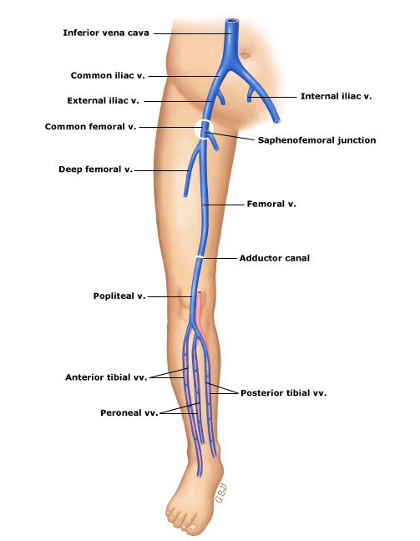
Deep veins of the leg
Deep veins of the right lower extremity. The paired tibial veins (anterior tibial, peroneal and posterior tibial) are shown with their adjacent arteries.
The bridging veins between the paired veins are also demonstrated. The popliteal and femoral veins are paired as well (omitted from the diagram); however, one usually dominate in size over the other.
COVID-19 & Blood Clots | www.stoptheclot.org

Slide 23
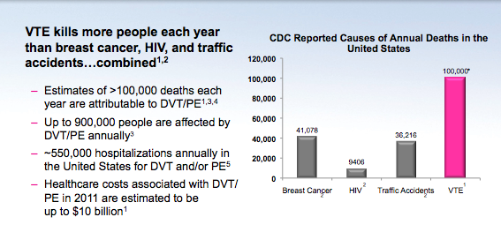
BURDEN OF VTE: PUTTING IT IN PERSPECTIVE
COVID-19 & Blood Clots | www.stoptheclot.org

Slide 24
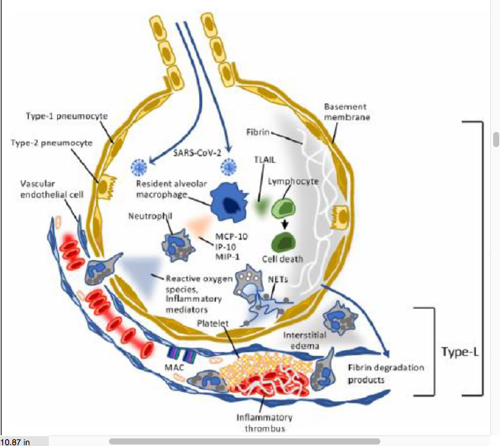
Endothelialitis and Thrombosis
Taken from Iba et al
COVID-19 & Blood Clots | www.stoptheclot.org

Slide 25
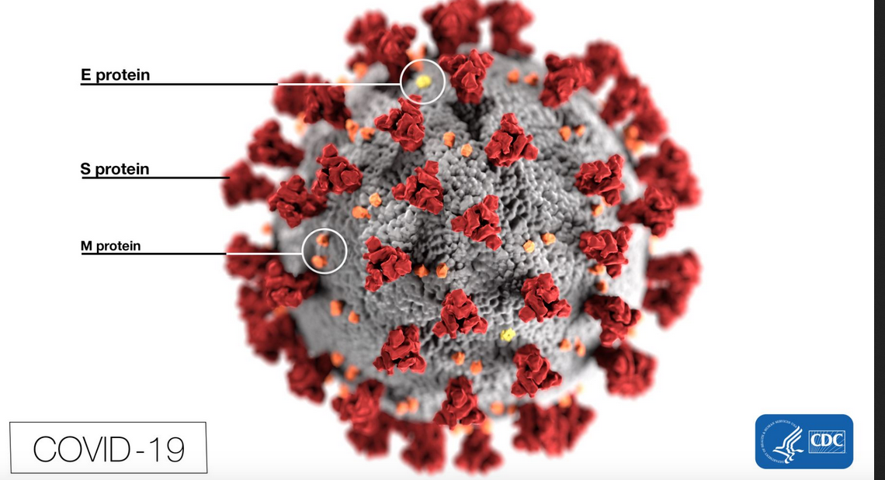
CORONAVIRUS
COVID-19 & Blood Clots | www.stoptheclot.org

Slide 26

Relaxed endothelium
COVID-19 & Blood Clots | www.stoptheclot.org

Slide 27

Activated endothelium
COVID-19 & Blood Clots | www.stoptheclot.org

Slide 28
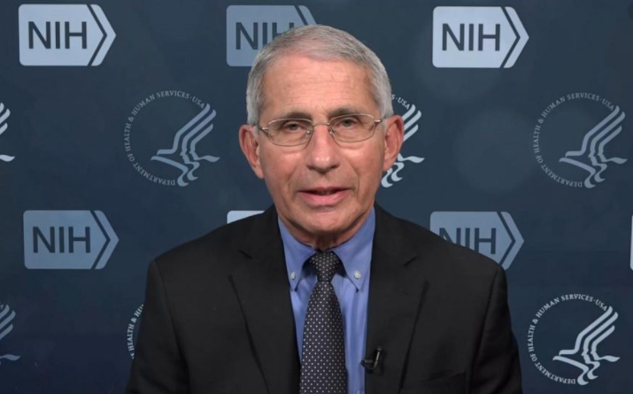
Messages from Dr. Fauci
COVID-19 & Blood Clots | www.stoptheclot.org

Slide 29
Messages
Wear masks
Distance
Wash hands
Avoid all crowds
Outside better than inside
COVID-19 & Blood Clots | www.stoptheclot.org

Slide 30
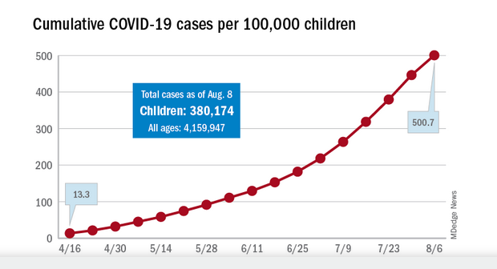
Cases in Children
COVID-19 & Blood Clots | www.stoptheclot.org

Slide 31
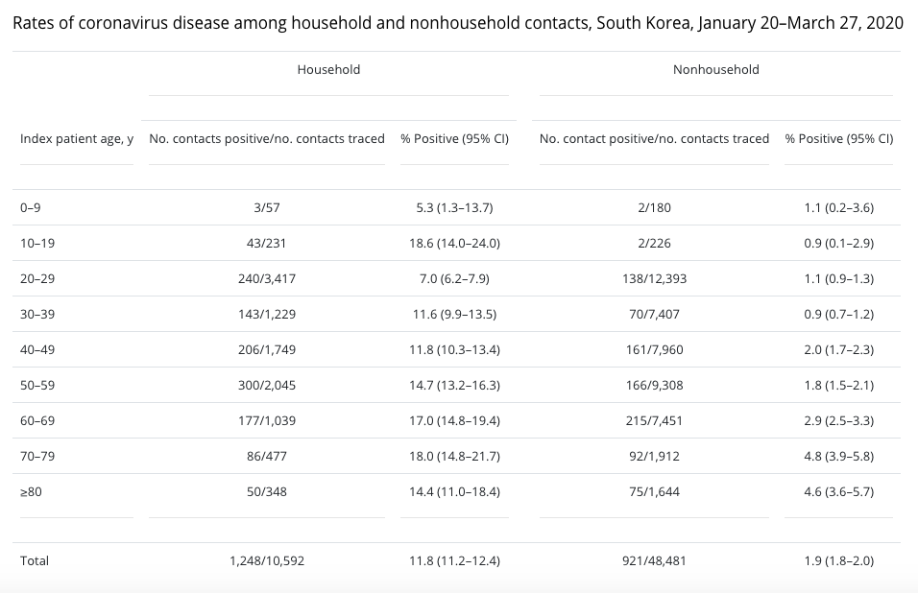
South Korea contacts by age
COVID-19 & Blood Clots | www.stoptheclot.org

Slide 32
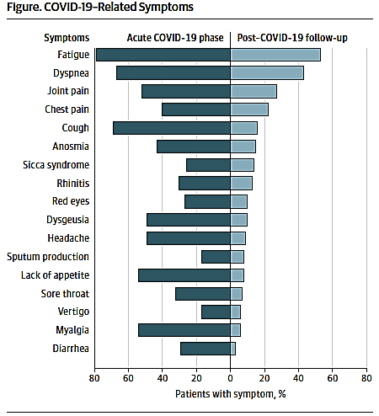
Not always just an acute disease
COVID-19 & Blood Clots | www.stoptheclot.org

Slide 33
Update on COVID-19 Vaccines
135+
20
8
2
Vaccines
not yet in
human trials
Testing vaccine safety at different doses
Vaccines
tested in expanded safety trials
Vaccines
in large-scale efficacy & safety trial
Vaccines approved for early or limited use
Moderna in collaboration with NIH started Phase 3 trials end of July.
Pfizer and BioNTech began Phase 3 trials at the end of July and plan to submit request for approval (NDA) to the FDA in October, anticipating Agency approval in December.
The New York Times, August 20,2020
COVID-19 & Blood Clots | www.stoptheclot.org

Slide 34
Collateral damage from COVID-19
Economics
School children
College students
Parents with children at home
Patients without COVID needing elective procedures
Mental health
Health care worker jeopardy
COVID-19 & Blood Clots | www.stoptheclot.org

Slide 35
Introduction to COVID-19 and the Complication of Blood Clots
Samuel Berkman, MD
Clinical Professor of Medicine
UCLA-Hematology/Oncology

