Slide 1

Venous Thromboembolism AND Cancer:
Prediction and prevention
Alok A. Khorana, MD
Taussig Cancer Institute
Case Comprehensive Cancer Center

Slide 2
DISCLOSURES
Consultant for Sanofi & Leo

Slide 3
Why You Should Care:
Prevalence, Consequences, Costs
Predicting VTE in Cancer
Preventing VTE in Cancer

Slide 4
Why You Should Care:
Prevalence, Consequences, Costs
Predicting VTE in Cancer
Preventing VTE in Cancer

Slide 5
Why You Should Care:
VTE AND MORTALITY
2nd leading cause of death in cancer patients
  Accounts for 9% of deaths ¹
  Associated with early mortality during chemotherapy (HR=6.98)²
  47-fold increased risk of mortality from VTE¹
Khorana AA et al. J Thromb Haemost 2007
Kuderer NM et al ASCO 2008 # 9521

Slide 6
Why You Should Care:
VTE and Mortality
HR=3.04* [95% CI: 1.31-7.15; P<0.01]
No VTE
VTE
Kuderer et al. ASCO 2009
*Adjusted for major confounders: Age, gender, race, cancer type, stage, year of therapy,
chemotherapy type and dose intensity, major laboratory abnormalities, PS, BMI, and comorbid conditions
Notes:
Title Slide 6
Subtitle
Based on our large 4,000 patient cohort study,
with detailed prospectively collected clinical information
In cancer patients starting chemotherapy:
We reported for the first time,
that VT is an independent risk factor for mortality,
Very early during the first 4 cycles chemotherapy–
in cancer patients of all stages
With a HR of approximately 3, after a detailed adjustment for all major clinical confounders:
Including cancer therapy and comorbid conditions.

Slide 7
Why You Should Care:
VTE and Public Health Burden
Patients with cancer: 19.8%
All DVT and PE
One-fifth of all VTE occurs in patients with cancer
Heit JA. et al. Arch Intern Med. 2002;162:1245-1248.
Notes:
Patients with cancer represent about 20% of all DVT and PE
[1/Heit.ArchlnternMed.
June.2002/p1247/Table]
_______________________________________________________________________________________
Heit JA, O’Fallon WM, Petterson TM, et al. Relative impact of risk factors for deep vein thrombosis and pulmonary embolism: see MRL. Arch Intern Med. 2002;162:1245-1248.

Slide 8
Why You Should Care:
Increasing Frequency of VTE In Malignancy
Pts on chemotherapy–
47% increase
All pts -28% increase
P<0.0001
Khorana AA et al. Cancer 2007

Slide 9
MSKCC Retrospective Analysis
932 patients receiving cisplatin-based chemotherapy at MSKCC in 2008
TEE occurred in 18.1%
Moore et al, JCO 2011

Slide 10
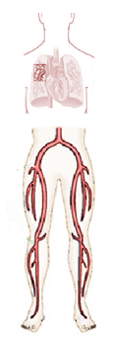
Cancer is Omnicoagulable
Natural history following major surgery
VTE in cancer with chemotherapy
Retrospective, single institution cohort study
N = 1,921 medical records of cancer patients (solid T + chemotherapy)
1/3
1/3
2/3
Kakkar VV et al. Lancet 1969, August 2: 230-33
Di Nisio et al. Thromb Haemost. 2010 Nov 3;104(5):1049-54.

Slide 11
Incidental VTE
VTE detected on imaging studies conducted for other indications, typically staging¹
  PE or DVT
  Visceral vein thrombosis
Term “asymptomatic” VTE discouraged; patients often have unrecognized symptoms²
Prevalence varies
  1.5-3.4% per scan in outpatient staging
  4-9% in hospitalized cancer patients
¹Khorana AA, et al. JTH 2012; ²O’Connell CL, et al. J Clin Oncol. 2006;24:4928-4932

Slide 12
Proportion of Incidental VTE
N=932 patients receiving cisplatin-based chemotherapy at MSKCC¹
N=1,151 scans of 135 pancreatic cancer patients at UR²
1. Moore et al, J Clin Oncol 2011
2. Menapace et al, Throm Haem 2011

Slide 13
Incidental vs Symptomatic PE in Cancer
Recurrent VTE
Survival
0.4
0.3
0.2
0.1
0
1.0
0.8
0.6
0.4
0.2
0
Incidental PE
Symptomatic PE
Incidental PE
Symptomatic PE
Cumulative Recurrence Rate
Cumulative Survival Rate
0 50 100 150 200 250 300 350 400
0 50 100 150 200 250 300 350 400
Follow-up Time (days)
Follow-up Time (days)
Den Exter PL, et al. J Clin Oncol 2011
P=0.77
P=0.70

Slide 14
Incidental VTE in Pancreas Cancer
Incidental and symptomatic VTE are both associated with worsened 3-month mortality in pancreatic cancer
100%
75%
50%
25%
0%
No prior event
≥ 1 asymptomatic VTE (but no symptomatic events)
≥ 1 Symptomatic VTE (DVT/PE/ VVT)
0 200 400 600 800 1000 1200
Menapace et al Throm Haem 2011

Slide 15
Why You Should Care:
Costs
Cancer patients with VTE had 3 times
  increase in all-cause hospitalizations (mean 1.38 versus 0.55 per patient)
  days in hospital (10.19 versus 3.37) (all P < 0.0001).
Cancer patients with VTE incurred
  higher overall all-cause inpatient costs (mean $21,299 versus $7459 per patient),
  outpatient costs ($53,660 versus $34,232 per patient), and
  total health care costs ($74,959 versus $ 41,691 per patient) (all P < 0.0001).
MeanVTE-related costs : $9247 / patient / year
Adjusted mean incremental all-cause costs of VTE : $30,538 /patient
Khorana et al, Clin Econ Outcomes Res; 2013

Slide 16
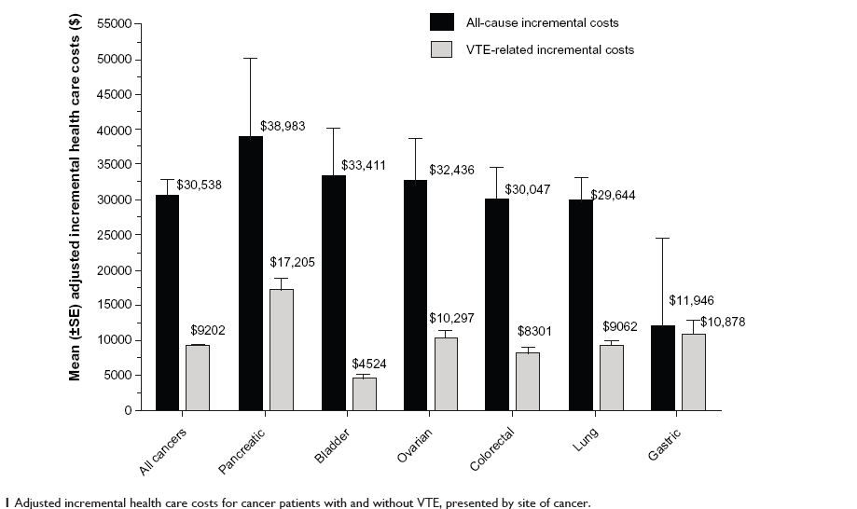
Why You Should Care:
Costs
Khorana et al, Clin Econ Outcomes Res; 2013

Slide 17
Why You Should Care:
Prevalence, Consequences, Costs
Predicting VTE in Cancer
Preventing VTE in Cancer

Slide 18
Risk Factors
Cancer-related
Primary Site
Histology
Treatment-related
Surgery/hospitalization
Chemotherapy
Patient-related
Anti-angiogenics
CVCs
ESA/transfusions
Initial period
Platelet counts
Leukocyte counts
Hemoglobin
Tissue factor
D-dimer
P-selectin
Biomarkers
Age
Ethnicity
Comorbidities
Grade
Thrombin generation potential

Slide 19
Risk of VTE by Primary Site
N = 17,284
% Patients
P<0.0001 for all
comparisons vs controls
Khorana AA et al, Cancer 2012

Slide 20
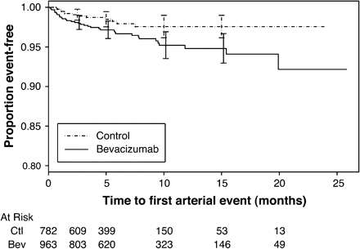
Risk with Bevacizumab
2-fold increased risk of arterial events¹
Possible increased risk of VTE [RR=1.29 (95% CI, 1.03-1.63)]²
Not significant if adjusted for exposure time [RR 1.10 (95% CI, 0.89-1.36)]³
Not seen in a newer pooled analysis (OR 1.14; 95% CI, 0.96 to 1.35; P = .13)⁴
¹Scappaticci et al JNCI 2007;99(16):1232-9; ² Nalluri SR, et al. JAMA. 2008;300:2277-2285; ³Chu & Wu JAMA. 2009;301(14):1434-1436; ⁴Hurwitz et al JCO 29(13):1757-6

Slide 21
Risk with Other Anti-Angiogenic Agents
Sunitinib and sorafenib are associated with risk of arterial events [ RR 3.03 (95% CI, 1.25 to 7.37; P=.015)]¹
VEGFR-TKIs (pazopanib, sunitinib, sorafenib and vandetanib) are not associated with VTE(RR=0.912, 95%CI: 0.617-1.348, p = 0.643)²
Risk of VTE with thalidomide- and lenalidomide-based regimens is well-known³
1.Choueiri et al JCO 2010; 28:2280-2285
2. Qi, et al. Int J Ca. 2013; 132(12):2967-7
3. Carrier et al J Thromb Haemost. 20119(4):653-63

Slide 22
Risk with Other Targeted Therapies
Anti-EGFR agents are associated with risk of VTE
  RR 1.32 (95% CI 1.07–1.63; P = 0.01)
  Risk primarily with antibodies (RR 1.34; P = 0.01) rather than oral TKIs (RR 1.16; P = 0.65)
Petrelli et al Ann Onc 2012 Jul;23(7):1672-9

Slide 23
Biomarkers
Leukocyte count
Platelet count
Hemoglobin
Tissue factor
D-dimer
Factor VIII

Slide 24
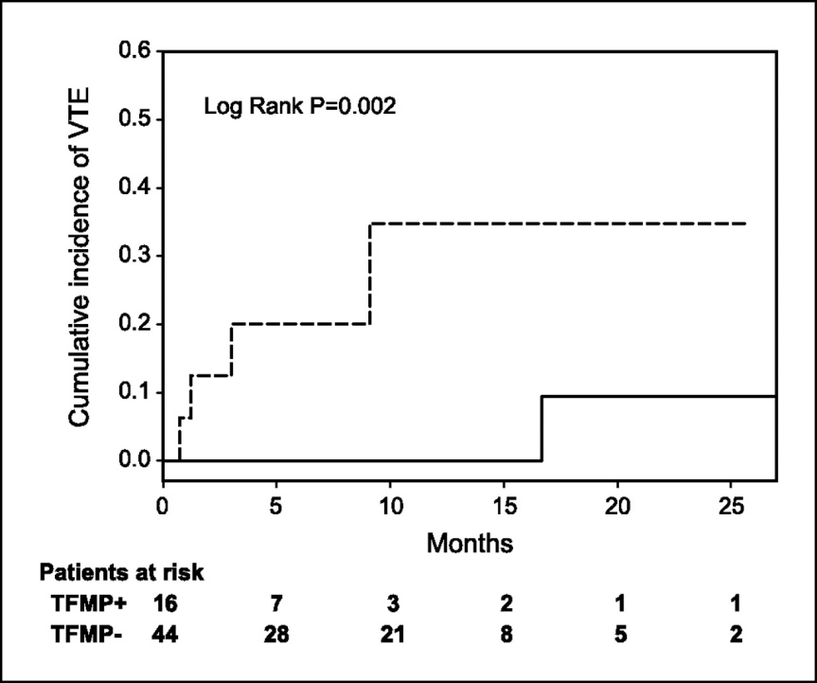
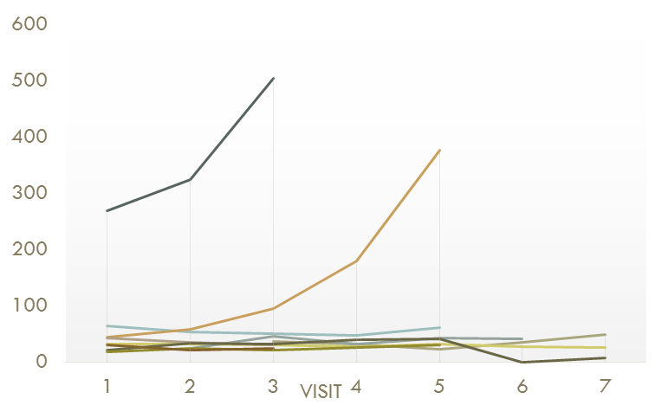
TF and VTE
DVT
DVT
Fatal PE
P = .04
Systemic TF-MPs by flow
cytometry²
Systemic TF by ELISA¹
Khorana AA, et al. J Thromb Haem 2008;6:1983-5
Zwicker J I et al. Clin Cancer Res 2009;15:6830-40

Slide 25
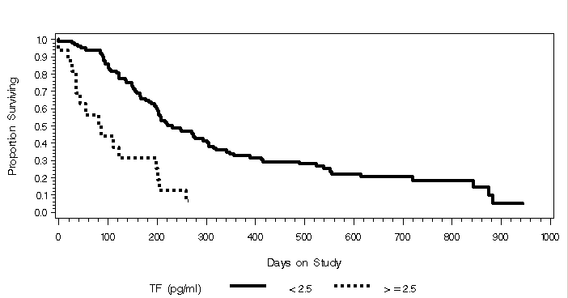
TF In Pancreatic & biliary Cancers
Elevated TF was significantly associated with TE in a logistic regression analysis, (OR = 1.22, p = 0.04)
Elevated TF was also associated with overall survival (HR = 1.05, p = 0.01)
Median survival was 98.5 days vs.231 days for high vs low TF (p< 0.0001)
Correlated with D-dimer and leukocyte count
Median Survival in 117 pts with TF MP-PCA >2.5 and </=2.5pg/ml.
Bharthuar et al ASCO 2010

Slide 26
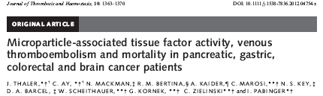
TF and VTE: Not So Fast
N= 348
MP-TF activity was not associated with future VTE
MP-TF activity was associated with mortality in pancreatic cancer
MP-TF activity correlated with D-dimer in pancreatic cancer
Thaler et al J Throm Haem 2012

Slide 27
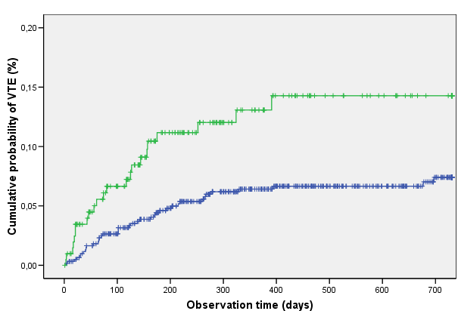
D-dimer and VTE
No consensus on cut-off levels
Widely available
Potential to discriminate intermediate-risk patients
Poor person’s TF?
Elevated D-dimer (>75th percentile, 1.44µg/mL); HR 2.2 (95% CI: 1.3 - 3.6), p=0.003
Elevated D-dimer (>75th percentile, 1.44µg/mL); HR 2.2 (95% CI: 1.3 - 3.6), p=0.003
Ay C et al, J Clin Oncol. 2009;27(25):4124-9

Slide 28
Risk Assessment
ASCO 2013 Guideline Update
“Individual risk factors, including biomarkers or cancer site, do not reliably identify cancer patients at high risk for VTE”
Lyman GH, et al. J Clin Onc 2013

Slide 29
Risk Score
Patient Characteristic | Score
Site of Cancer Very high risk (stomach, pancreas) High risk (lung, lymphoma, gynecologic, GU excluding prostate) | 2 1
Platelet count > 350,000/mm³ | 1
Hb < 10g/dL or use of ESA | 1
Leukocyte count > 11,000/mm³ | 1
BMI > 35 kg/m² | 1
Khorana AA et al. Blood 2008
Notes:
Based on the multivariate analysis, we developed a predictive risk model for identifying patients at high risk for development of VTE at time of initiation of chemotherapy. Risk scores were developed based on the beta-coefficient for each variable in the multivariate model shown on the prior slide, rounded to the nearest integer to make the model clinically usable. A patient with a very high risk site of cancer (such as stomach or pancreas) would be assigned a score of 2; patients with high risk sites of cancer (such as lung, lymphoma, gynecologic or GU cancers) as well as elevated pre-chemotherapy platelet count, anemia with a Hgb < 10 g/dL or use of erythropoiesis-stimulating agent, elevated leukocyte count or a BMI >=35 would all be assigned scores of 1.

Slide 30
Risk Model Validation
8%
7%
7.1%
Development cohort
6.7%
6%
Validation cohort
5%
4%
Rate of VTE over 2.5 mos (%)
3%
2%
1.8%
2.0%
1%
0.8%
0.3%
0%
n=734
n=374
n=1627
n=842
n=340
n=149
Risk Low (0) Intermediate(1-2) High(>3)
Khorana AA et al. Blood 2008

Slide 31
Vienna CATS validation
Full data available in 839 patients
Median observation time/follow-up: 643 days
 | Number of
 | Patients | Events
 | n | n (%)
Score ≥3 | 96 | 16 (17%)
Score 2 | 231 | 25 (11%)
Score 1 | 233 | 14 (6%)
Score 0 | 279 | 7 (3%)
17.7%
Score ≥3
Score 2
9.4%
Score 1
3.8%
Score 0
1.5%
6 months
Ay et al Blood 2011

Slide 32
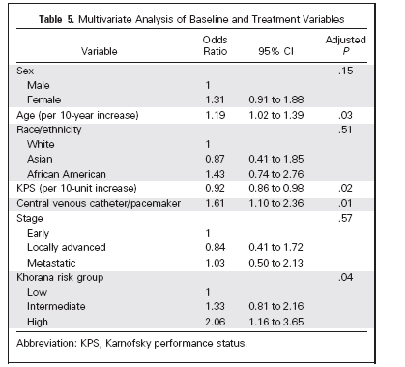
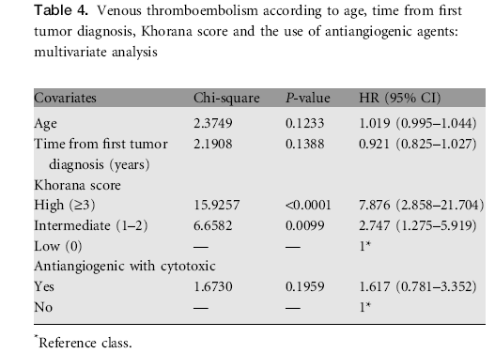

External Validation of Risk Score
N=932¹
N=1,415²
¹Moore et al, J Clin Oncol 2011
²Mandala et al, Ann Onc 2012

Slide 33
Evaluation of Risk Score
N=10, 694
Study | Type, duration | N | Low-risk (score = 0) | Intermediate-risk (score = 1-2) | High-risk (score ≥3)
Khorana et al, 2008 | Development cohort, 2.5 months | 2701 | 0.8% | 1.8% | 7.1%
Khorana et al, 2008 | Validation cohort, 2.5 months | 1365 | 0.3% | 2% | 6.7%
Kearney et al, 2009 | Retrospective, 2 years | 112 | 5% | 15.9% | 41.4%
Price et al, 2010 | Retrospective, pancreatic, NA | 108 | - * | 14% | 27%
Ay et al, 2010 | Prospective, 643 days | 819 | 1.5% | 9.6% (score= 2) 3.8% (score=1) | 17.7%
Khorana et al, 2010 | Prospective**, 3 months | 30 | - *** | - | 27%
Moore et al, 2011 | Retrospective, cisplatin-based chemo only | 932 | 13% | 17.1% | 28.2%
Mandala et al, 2012 | Retrospective, phase I patients only, 2 months | 1415 | 1.5% | 4.8% | 12.9%
NA=not available; *=pancreatic cancer patients assigned a score of 2 based on site of cancer and therefore no patients in the low-risk category; **included 4-weekly screening ultrasonography; ***enrolled only high-risk patients

Slide 34
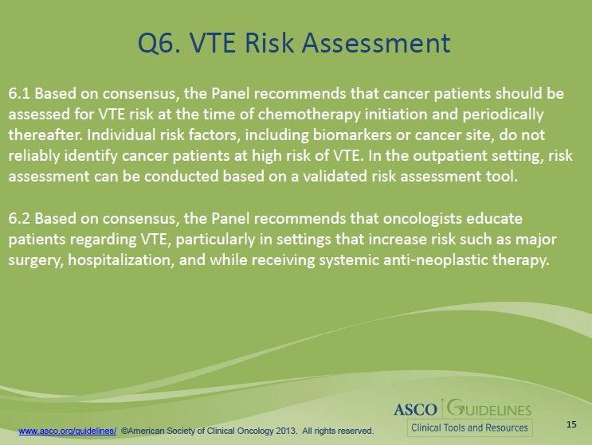
Risk Assessment: The Present
ASCO 2013 New Recommendation

Slide 35
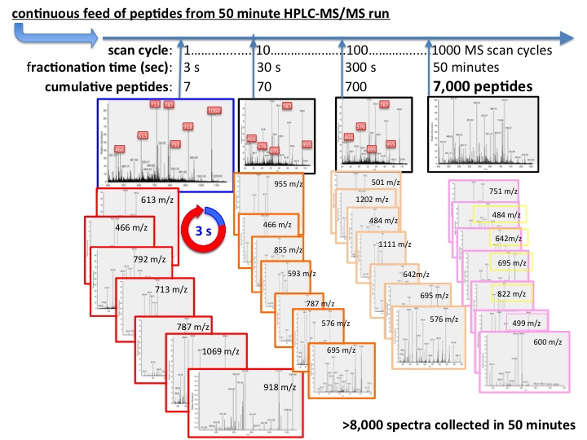
Risk Assessment: The Future
High coverage LC-MS/MS
>50637 spectra
2145 unique peptides
149 proteins
116 protein groups
Differential expression
  9 proteins p <0.05
  23 proteins p<0.10
Match criteria: 3 peptide minimum and 95% probability of match
Connolly et al, ISTH 2013
Notes:
Continuous throughput from the LC with MS scanning every 3 seconds creates many peptide spectra. These spectra are basically graphs of the mass/charge (x axis) vs signal intensity (y axis). Mass and sequence information generated from spectra is then referenced against large database of known proteins. Our analysis generated thousands of spectra, corresponding to over 2000 unique peptides which mapped to almost 150 unique proteins and 116 protein groups when applying strict match criteria 3 peptide minimum and 95% probability match. When comparing the quantitative spectra data for these proteins between patients with and without VTE we identified 9 proteins with differential expression when compared by ttest with p value 0.05.

Slide 36
Applying Risk Assessment
Screening?
Prophylaxis?
Patient Awareness and Education
Risk Score

Slide 37
Risk Assessment

Slide 38
Applying Risk Assessment
Screening
Khorana AA et al. ASH 2010

Slide 39
Why You Should Care:
Prevalence, Consequences, Costs
Predicting VTE in Cancer
Preventing VTE in Cancer

Slide 40
Preventing VTE in Cancer
Cancer Patients
Clinical setting
Major cancer surgery
Hospitalization for acute medical illness
Outpatient chemotherapy
ENOXACAN-1
Canadian Colorectal DVT Prophylaxis
ENOXACAN-2
FAME
CANBESURE
MEDENOX
PREVENT
EXCLAIM
PROTECHT
CONKO-004
FRAGEM
SAVE-ONCO

Slide 41
Despite Evidence, Prophylaxis Is Underused
ENDORSE¹
IMPROVE²
 | Medical | Surgical
No. of patients | 37,356 | 30,827
At risk for VTE | 42% | 64%
Received prophylaxis(ACCP) | 40% | 59%
 | United States | Other Countries
No. of patients | 3,410 | 11,746
VTE prophylaxis | 1852 (54%) | 5788 (49%)
LMWH | 476 (14%) | 4657 (40%)
UFH | 717 (21%) | 1014 (9%)
1. Cohen AT et al. Lancet. 2008;371:387-394.
2. Tapson VF et al. Chest. 2007;132:936-945.
Notes:
41
Bad news: Despite the well recognized risks of VTE and the benefits of prophylaxis in hospitalized patients, the majority of patients at risk remain untreated.
The ENDORSE (Epidemiologic International Day for the Evaluation of Patients at Risk for Venous Thromboembolism in the Acute Hospital Care Setting) study evaluated the proportion of medical and surgical patients at risk who received prophylaxis.¹ Patients were enrolled from 358 randomly selected hospitals in 32 countries. Of the 68,183 patients enrolled, a mean of 52% were at risk for VTE, including 64% of surgical and 42% of medical patients. However, only 59% of surgical and 40% of medical patients were receiving appropriate prophylaxis, AKA ACCP-guideline recommended VTE prophylaxis.
Only 37% of patients with active malignancy received prophylaxis
The IMPROVE (International Medical Prevention Registry on Venous Thromboembolism) study evaluated risk and prophylaxis use in the US vs other countries.² A total of 15,156 patients were enrolled from 52 hospitals in 12 countries. Only 54% of patients in the US and 49% outside the US who were at risk received VTE prophylaxis.
Cohen AT, Tapson VF, Bergmann JF, et al. A large-scale, global observational study of venous thromboembolism risk and prophylaxis in the acute hospital care setting: the ENDORSE study. Presented at: the International Society on Thrombosis and Haemostasis; July 8-11, 2007; Geneva, Switzerland.
Tapson VF, Decoucus H, Pini M, et al. Venous thromboembolism prophylaxis in acutely ill hospitalized medical patients. Findings from the International Medical Prevention Registry on Venous Thromboembolism. Chest. 2007;132:936-945.

Slide 42
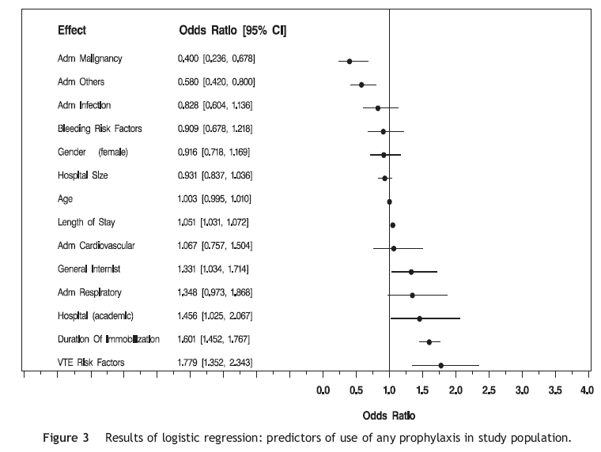
Prophylaxis is underutilized in cancer patients
Kahn SR et al Throm Res 2007

Slide 43
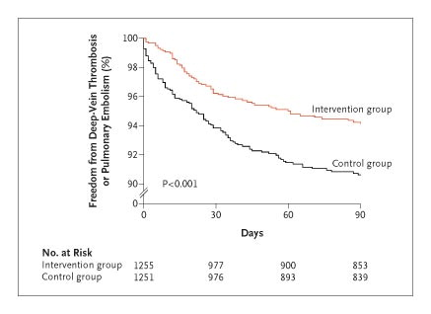
Order Entry Alerts Improve Compliance and Reduce VTE
Kucher N et al. N Engl J Med 2005;352:969-977.
Notes:
Figure 1. Kaplan–Meier Estimates of the Absence of Deep-Vein Thrombosis or Pulmonary Embolism in the Intervention Group and the Control Group. P<0.001 by the log-rank test for the comparison of the outcome between groups at 90 days.

Slide 44
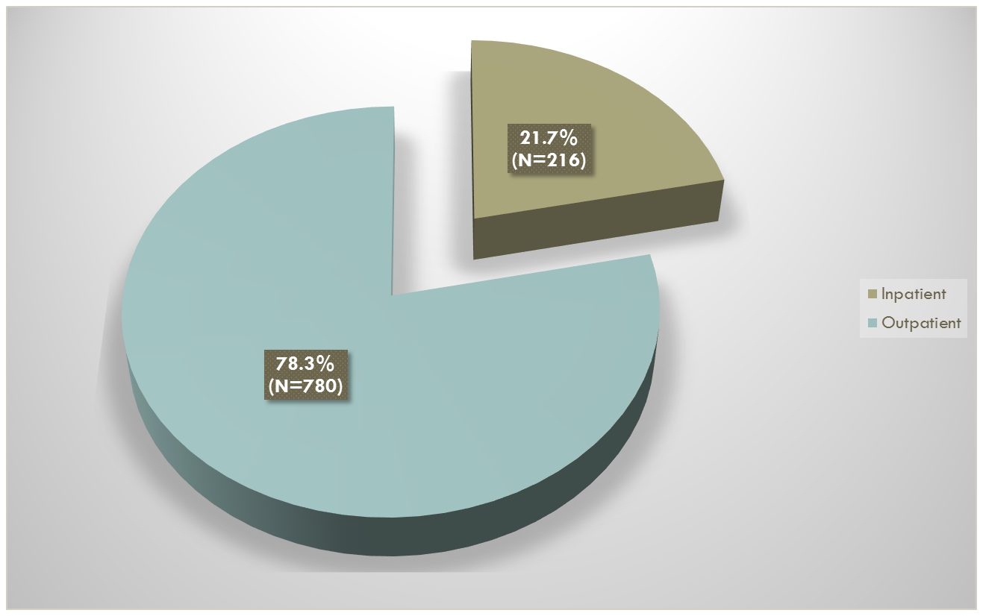
Prevention:
CAT is an outpatient illness
Khorana et al ASH 2011

Slide 45
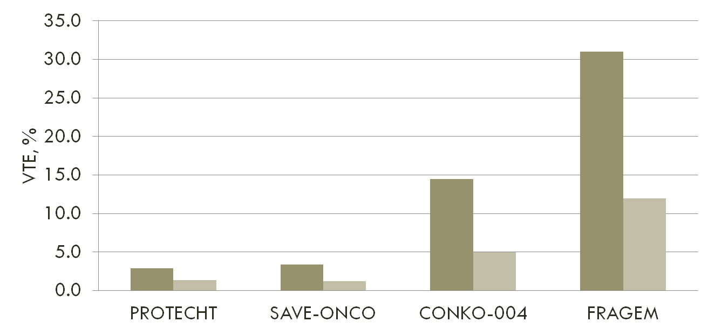
Rates of VTE in Recent Prophylaxis Studies
Agnelli et al Lancet Onc 2009
Riess et al ISTH 2009
Maraveyas et al ESMO 2009
Agnelli et al NEJM 2012

Slide 46
How To Approach Outpatient Prophylaxis?
“Specific” studies
CONKO, FRAGEM, Myeloma
Very high event rates
“General” studies
PROTECHT, SAVE-ONCO
Lower event rates
Homogenous populations (pancreas, myeloma)
Heterogenous populations (multiple sites, stages, chemo)
But: potential greater effect on public health burden
But: smaller effect on public health burden

Slide 47
Risk Assessment: The Future-Prophylaxis
PROTECHT by Risk Score
NNT 50 77 15
Verso et al, Int Emerg Med 2012

Slide 48
Guideline recommendations
Patients | ASCO¹ | NCCN² | ESMO³
All cancer outpatients | Routine prophylaxis not recommended | Routine prophylaxis not recommended | Routine prophylaxis not recommended
Myeloma patients, receiving imid-based regimens | Aspirin or LMWH for low-risk and LMWH for high-risk patients is recommended | Aspirin for low-risk and LMWH or warfarin for high-risk patients is recommended | Consider LMWH, aspirin or adjusted-dose warfarin (INR ∼ 1.5)
“High-risk” outpatients | Consider LMWH prophylaxis on a case-by-case basis in highly select outpatients with solid tumors on chemotherapy. | “Consider patient conversation about risks and benefits of prophylaxis in Khorana score ≥ 3 population” | Consider in high-risk ambulatory cancer patients. Predictive model may be used to identify patients clinically at high risk for VTE
Lyman GH, et al. J Clin Oncol. 2013
NCCN guidelines, 2013
Mandala M, et al. Ann Oncol. 2011;21:274-6.

Slide 49
Conclusions
The problem is bigger than we imagined
We have made progress
Validation of the Risk Score by multiple groups represents a new era in collaboration and testing of predictive models
Association with cancer outcomes, including mortality
“Unacceptably high” burden
Candidate biomarkers are being vetted in large-scale studies
Multiple RCTs have addressed prevention of CAT in the outpatient setting
Incidental VTE is an emerging major clinical problem
Electronic alerts increase compliance and reduce clots

Slide 50
Conclusions
Outpatient prophylaxis is safe, feasible and effective
Multiple RCTs have shown benefit, but with low event rates
Risk-adapted approaches to prophylaxis
Identifying high-risk patients reduces NNT and optimizes risk-benefit ratio
Slouching toward a consensus: targeted prophylaxis

Slide 51
The Future of CAT
Precision medicine
Prevention and treatment can be individualized to patients based on risk of VTE and risk of bleeding
“Big data” and pan-omics can be harnessed to precisely estimate the risk of primary and recurrent VTE

