Slide 1
Preventing Hospital-Associated Venous Thromboembolism:
Practical Strategies That Work
Greg Maynard M.D., M.Sc,SFHM
Clinical Professor of Medicine
CQO, UC Davis Medical Center
March 19, 2015
CDC Webinar
1

Slide 2

Conflict of Interest
Executive Committee -
Mariner VTE Prevention trial of extended duration prophylaxis in medical patients
AHRQ DVT Prevention Guide author
2

Slide 3
Abbreviations – Terms
VTE – venous thromboembolism
VTE-P VTE Prevention / prophylaxis
HA VTE – hospital-associated VTE
CDS - Clinical decision support
IPCD – intermittent pneumatic compression devices
SCD – sequential compression devices
GCS – graduated compression stockings
Extended duration prophylaxis - beyond hospital stay
LMWH - low-molecular weight heparin
UFH - unfractionated heparin
LDUH - low dose unfractionated heparin
PAH - Pulmonary artery hypertension
AT8 - ACCP Anticoagulation / DVT Prevention guidelines (2008)
AT9 - ACCP Anticoagulation / DVT Prevention guidelines (2102)
3

Slide 4
A Major Source of Mortality and Morbidity
VTE
350,000 to 650,000 with VTE per year
100,000 to > 200,000 deaths per year
About half are hospital related.
VTE is primary cause of fatality in half-
  More than HIV, MVAs, Breast CA combined
  Equals 1 jumbo jet crash / day
10% of hospital deaths
  PE among top sources of preventable hospital related death
Huge costs and morbidity (recurrence, post-thrombotic syndrome, chronic PAH, anticoag)
4
Surgeon General’s Call to Action to Prevent DVT and PE 2008 DHHS
Notes:
1 in 10 of the > 2 million Americans developing DVT goes on to die from pulmonary embolism (PE).
These 200,000 patient deaths represent more annual deaths than those from breast cancer, AIDS, and traffic accidents combined.
Many of these VTE deaths contribute to hospital mortality.
Pulmonary embolism is the most common preventable cause of death in the hospital; an estimated 10% of inpatient deaths are secondary to PE.
Not only do patients with VTE suffer a 30% cumulative risk for recurrence, they are also at risk for the potentially disabling post-thrombotic syndrome.

Slide 5
QI Framework and Strategies that Work
Sources
UC San Diego and Univ. of California VTEP Collaborative
SHM / AHRQ improvement guides and Collaborative
Experience, mentoring other hospitals via UCSD CIIS
Johns Hopkins experience
Systematic reviews
Kahn SR, Morrison DR, Cohen JM, Emed J, Tagalakis V, Roussin A, Geerts W. Interventions for implementation of thromboprophylaxis in hospitalized medical and surgical patients at risk for venous thromboembolism (Review). Cochrane Database of Systematic Reviews 2013, Issue 7. Art. No.: CD008201. DOI: 10.1002/14651858.CD008201.pub2.
Streiff MB, Carolan HT, Hobson DB, Kraus PS, Holzmueller CG, Demski R, et al. Lessons from the Johns Hopkins Multi-Disciplinary Venous Thromboembolism (VTE) Prevention Collaborative. BMJ 2012; Jun 19;344:e3935.
Kakkar AK, Davidson BL, Haas SK. Compliance with recommended prophylaxis for venous thromboembolism: improving the use and rate of uptake of clinical practice guidelines. J Thromb Haemost. 2004;2:221–227.
Tooher R, Middleton P, Pham C, et al. A systematic review of strategies to improve prophylaxis for venous thromboembolism in hospitals. Ann Surg 2005; 241:397–415.
Maynard G, Stein J. Designing and Implementing Effective VTE Prevention Protocols: Lessons from Collaboratives. J Thromb Thrombolysis 2010 Feb:29(2):159-166.
5

Slide 6
Strategies to Reduce HA VTE
Centralized steering group for institution wide approach
Review and distill the evidence / best practices
Standardize – Create a VTE Prevention Protocol
Embed protocol guidance into order sets, hard stops for use on admission, transfer, and post op – Provide seamless CDS
Go beyond core measures / SCIP - better measures
Active day-to-day surveillance, in addition to monthly / quarterly
Multiple mutually reinforcing interventions to reinforce protocol
Active vs passive interventions
Address adherence / administration of prophylaxis
Address other failure modes / contributing factors to HA VTE
6

Slide 7
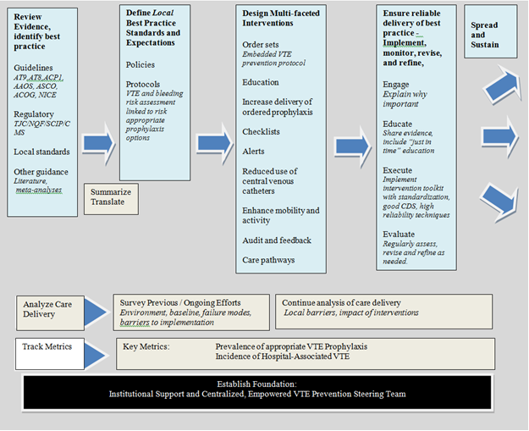
7
Notes:
Figure 1.1: Framework for Improving VTE Prevention. A VTE prevention protocol incorporates VTE and bleeding risk assessment tools and risk appropriate prophylactic options. Relying on order sets alone will not reach desired levels of appropriate VTE prophylaxis. Analyzing care delivery, assessing and addressing barriers, and ongoing measurement and monitoring are also essential.
Many concepts and strategies are introduced in Chapter 1, then explained in more detail in subsequent chapters.

Slide 8
The Essential First Intervention
Protocol
VTE Protocol
1) a standardized VTE risk assessment, linked to…
2) a menu of appropriate prophylaxis options, plus…
3) a list of contraindications to pharmacologic VTE prophylaxis
Challenges:
Make it easy to use (“automatic”)
Make sure it captures almost all patients
Trade-off between guidance and ease of use / efficiency
8
Notes:
8
The standardized VTE risk assessment ‘stratifies risk’
The menu of appropriate prophylaxis options ‘makes it easy to order an evidence-based choice for prophylaxis’
The list of contraindications does several things ‘highlights the conditions and timing where anticoagulation is relatively or absolutely contraindicate’ and ‘addresses doubts providers may have about risk of bleeding’

Slide 9
Characteristics of the hypothetical ideal protocol
Trade-offs and prioritization of characteristics often needed
Protocol
Accurately detects all patients at risk for DVT.
Reliably excludes patients who would be unlikely to develop DVT, minimizing inappropriate over-prophylaxis in those of lower risk.
Provides actionable recommendations for permutations of VTE and bleeding risk.
Simple to use in routine clinical practice
Identifies patients that should have a combination of mechanical and anticoagulant prophylaxis.
Lends itself to automation or dynamic ongoing re-evaluations.
Integration results in convincing decreases in hospital-associated VTE without any increase in bleeding.
9

Slide 10
Hierarchy of Reliability
Predicted
Prophylaxis rate
Level
1
No protocol* (“State of Nature”)
Decision support exists but not linked to order writing, or prompts within orders but no decision support
Protocol well-integrated
(into orders at point-of-care)
Protocol enhanced
(by other QI / high reliability strategies)
Oversights identified and addressed in real time
40%
2
50%
3
65-85%
4
90%
5
95+%
10
Notes:
Ideally, we’d find a way to check on all best practice performance in real time, and correct it before patient went on to next stage.

Slide 11
Protocol
Local Standards of best practice
Written out
Algorithmic decision trees can be useful
Include operational definitions*
Must have enough detail to be measurable and make judgments re:
Is this case meeting our standard of care?
Examples requiring operational definitions*
  High INR
  Low platelet counts
  Impaired mobility
  “Low Risk”
11

Slide 12
Prompt - Not a protocol - No CDS offered
DVT PROPHYLAXIS ORDERS
Anti thromboembolism Stockings
Sequential Compression Devices
UFH 5000 units SubQ q 12 hours
UFH 5000 units SubQ q 8 hours
LMWH (Enoxaparin) 40 mg SubQ q day
LMWH (Enoxaparin) 30 mg SubQ q 12 hours
No Prophylaxis, Ambulate
12
Notes:
In this example, options are listed without any guidance….essentially, this is a prompt, not a protocol. Note that ‘no prophylaxis’ looks like an equally acceptable choice to LMWH…expect mediocre performance.

Slide 13
Over 20 different VTE risk assessment models
No consensus on what is best in clinical practice
Individualized point-based scoring (quantitative) models
  Generally more rigorously validated in determining risk, but not in clinical practice
  Examples:
  Caprini
  Padua
  IMPROVE
Grouping or “bucket” models
  Generally not as well validated in predicting risk, but easier to implement, more published / unpublished success stories in reducing HA VTE
  Examples:
  NICE / NHS guidelines, Australia / New Zealand working group model
  Classic “3 bucket” model
  Updated “3 bucket” grouping model
13

Slide 14
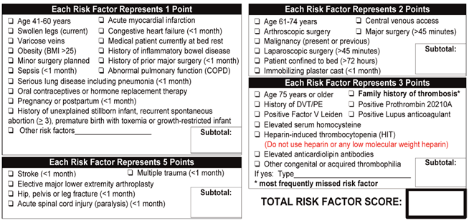
Caprini Model
Validated in predicting risk
Can be difficult to use reliably
Only 1 published success in clinical practice published after 30 years of use.
Works best in centers with advanced CDS to make it easier / more automated
14

Slide 15
Risk Assessment
15

Slide 16
J Hosp Med 2010 Jan:5(1):10-18.
N = 2,944 mean 82 audits / month
Real time ID & intervention
Real time ID & intervention
Order Set Implementation & Adjustment
Order Set Implementation & Adjustment
Consensus building
Consensus building
Baseline
Baseline
16
16
Notes:
16
UCSD experience with thousands of randomly sampled inpatient: High bar for ‘adequate prophylaxis’ Note real time ID / intervention

Slide 17
UCSD results
2008
80
12
68
6
17
J Hosp Med 2010 Jan:5(1):10-18.
Notes:
17

Slide 18
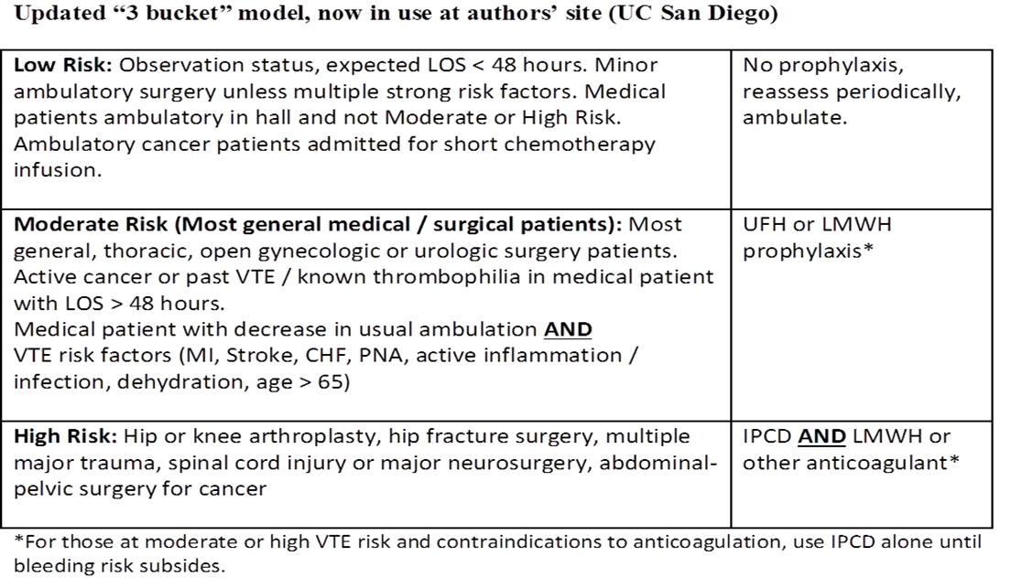
Updated Model – More c/w AT9 guidelines
18

Slide 19
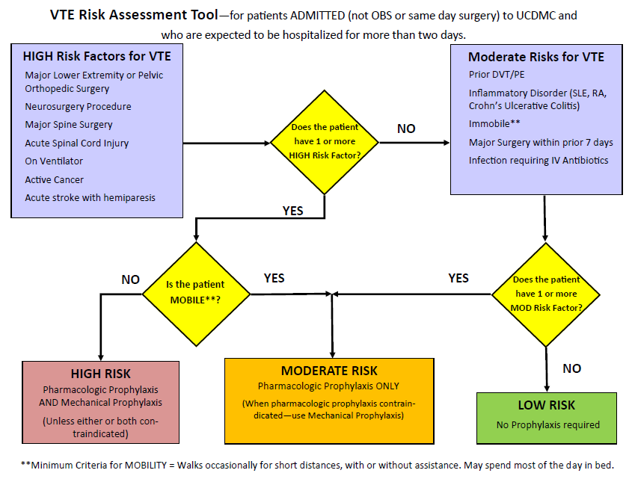
UC Davis Medical Center
3 bucket model algorithm assoc. w/ reduction in HA VTE
Courtesy Dr. Richard White
19

Slide 20
Effective Implementation / CDS Principles
Keep it simple for the end user
  Some adjustments can be done behind the scenes (pharmacy adjustment of dose or periop timing, for example)
  Minimize calculations / clicks, automate process for them
  Streamline options, offer only preferred choices
Don’t interrupt the work flow
  Integrate risk assessment in admit / transfer / post op process
  Keep VTE risk assessment, bleeding risk assessment, and ordering of risk-appropriate prophylaxis together as a unified process.
Design reliability into the process
  Forcing functions / hard stop for VTEP
  Present preferred risk appropriate prophylaxis as the default option once risk level chosen
  Scheduling and redundant checks for highest risk patients
  Standardization for services / groups of patients (discourage over-customization at provider level)
20

Slide 21
Effective Implementation / CDS Principles
4. Pilot interventions on a small scale
  Engage medical staff groups, look for barriers and special needs
  Use case histories or real patient scenarios to simulate use of the order set
5. Monitor use of the protocol. Build measurement and monitoring into order set and documentation tools
  Capture VTE risk, declaration of contraindications, what is ordered
  Ambulation, IPCD adherence
  Audits – order sets being used? Completed properly?
  Learn for variation from protocol
21

Slide 22
Key Strategies
Implementing Caprini Model
Courtesy Marc Moote, PA-C
Scope: ALL adult inpatients
Standardized VTE Protocol – Caprini model
Mandatory risk assessment with CPOE hard-stop
Clinical decision support to drive clinical practice
Required documentation of contraindications
Data feedback to services regarding performance
VTE prophylaxis included as peer review (OPPE) indicator for many services
Review of EVERY VTE event that occurs in the health system for preventability

Slide 23
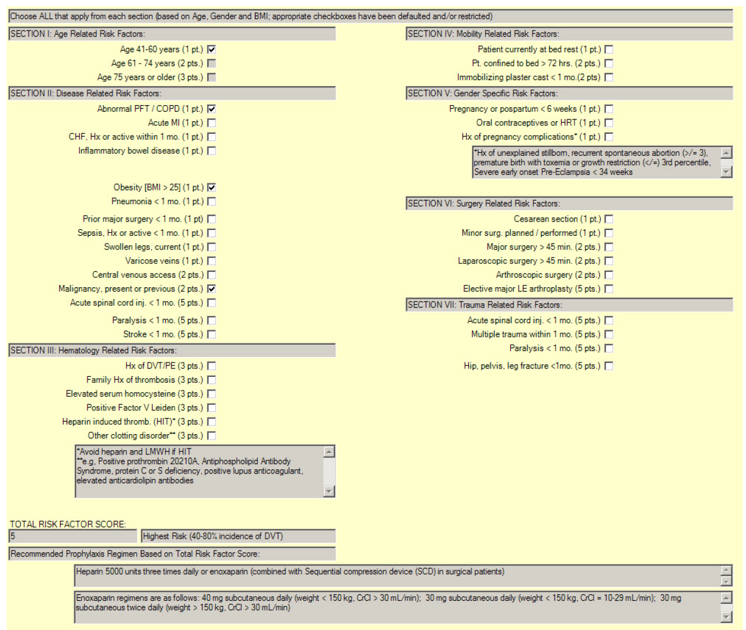
Reorganization / grouping of Caprini VTE risk factors make it more user friendly
Point total calculated for user, prophylaxis recommendation based on risk score
23

Slide 24
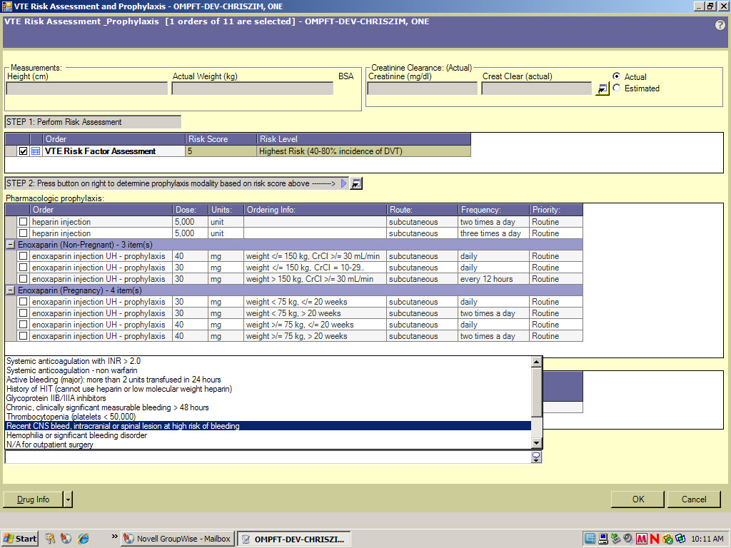
VTE Risk Level, contraindications (if present) and ordered prophylaxis capture for analysis
Order Recommended prophylaxis unless contraindicated

Slide 25
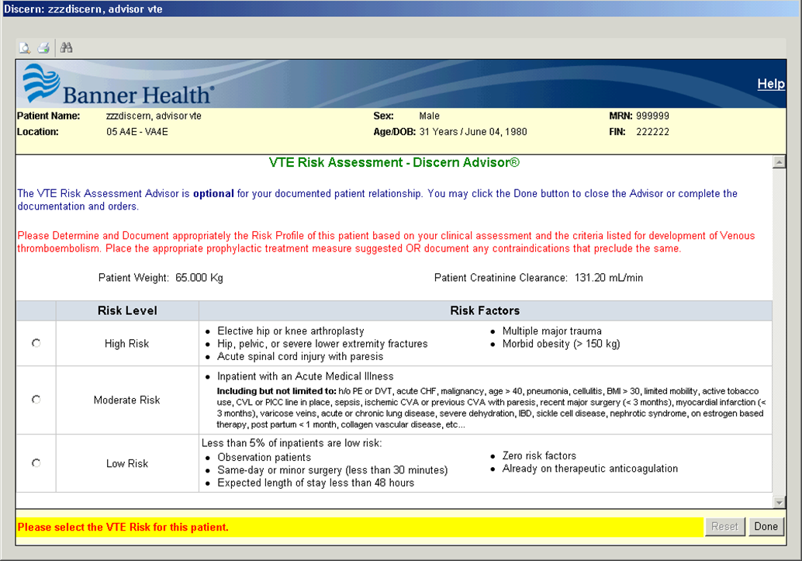
Classic 3 bucket model implementation
Courtesy Dr. Lori Porter, Good Samaritan Regional Medical Center
25
Notes:
On admission / transfer, VTE risk assessment must be completed

Slide 26
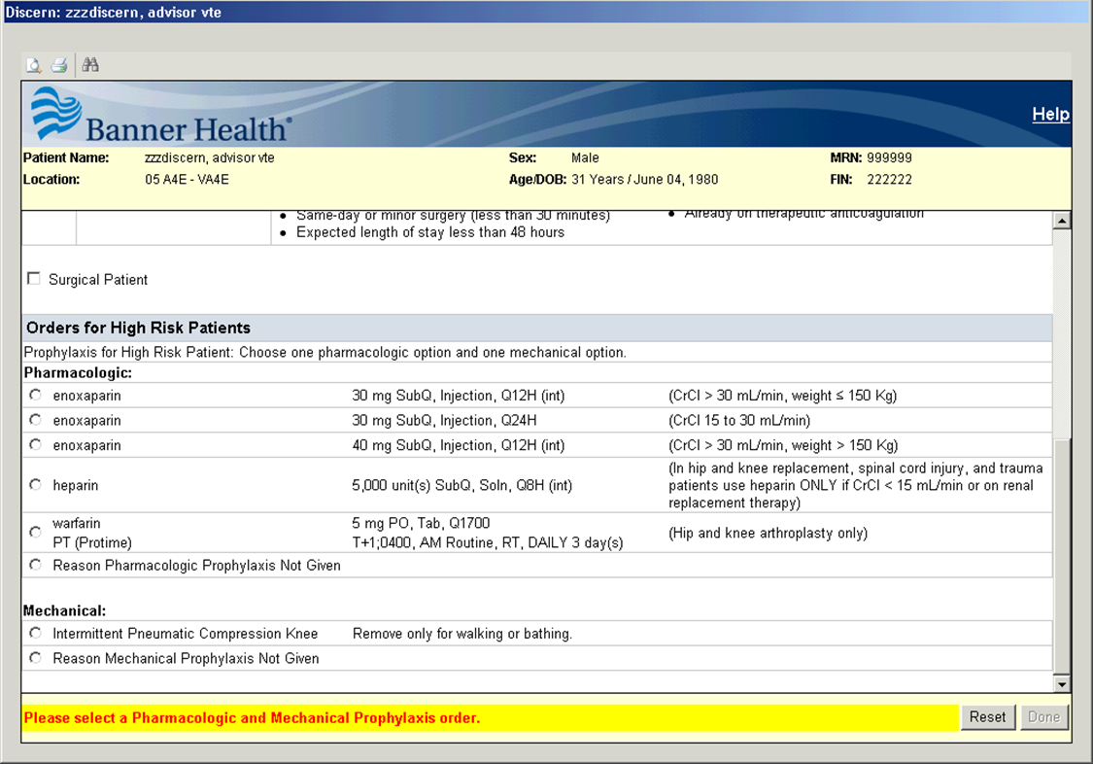
Risk-appropriate prophylaxis options appear after risk level chosen. High Risk requires dual prophylaxis
26

Slide 27
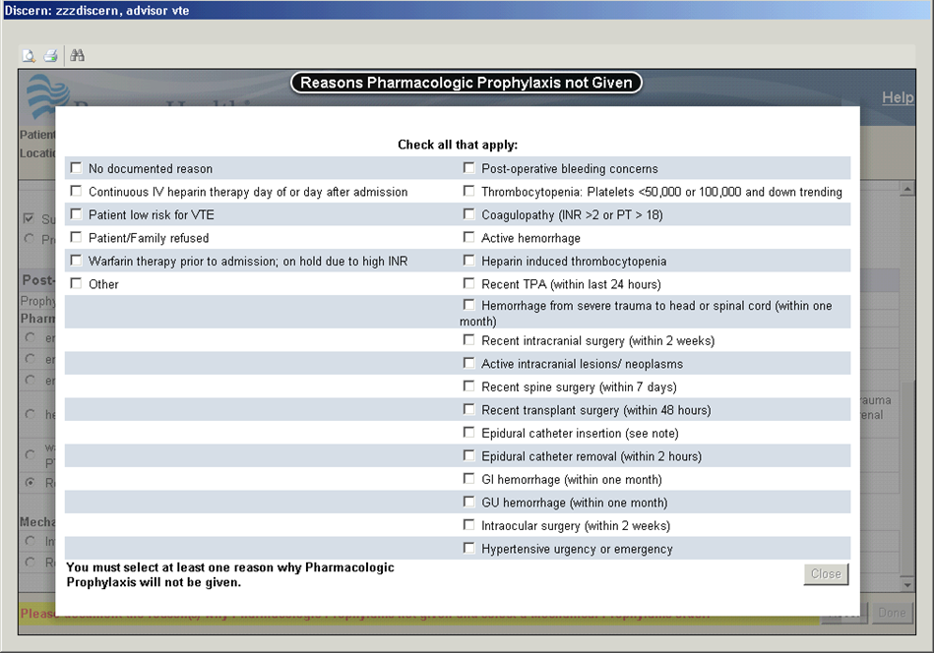
Contraindications captured if pharmacologic prophylaxis not ordered for a patient at risk of DVT.
27

Slide 28
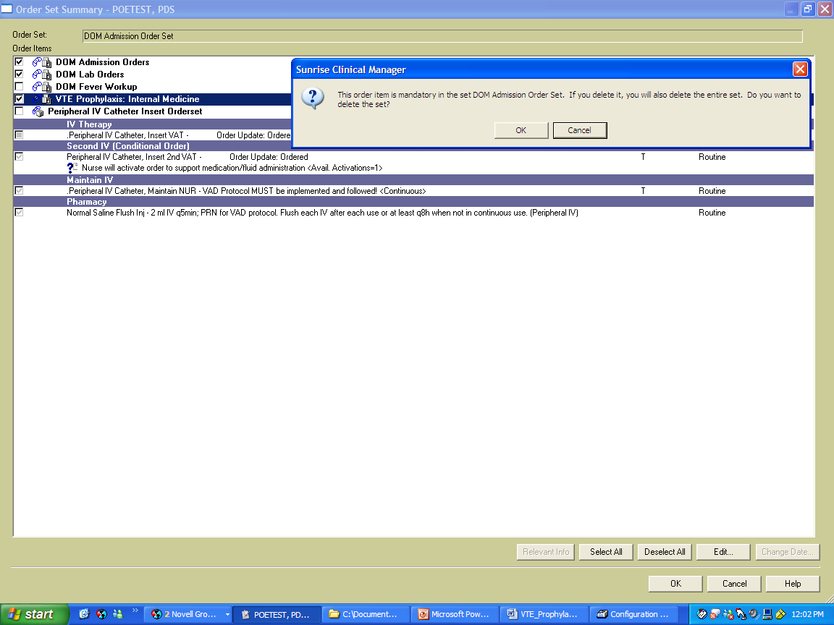
Any Attempt to uncheck the order will give this message
Johns Hopkins Medicine DVT Prevention Order Set Example
Courtesy Dr. Michael Streiff
Embedded in Medicine Admission Orders
Hard Stop to use (vs delete entire order set)
28

Slide 29
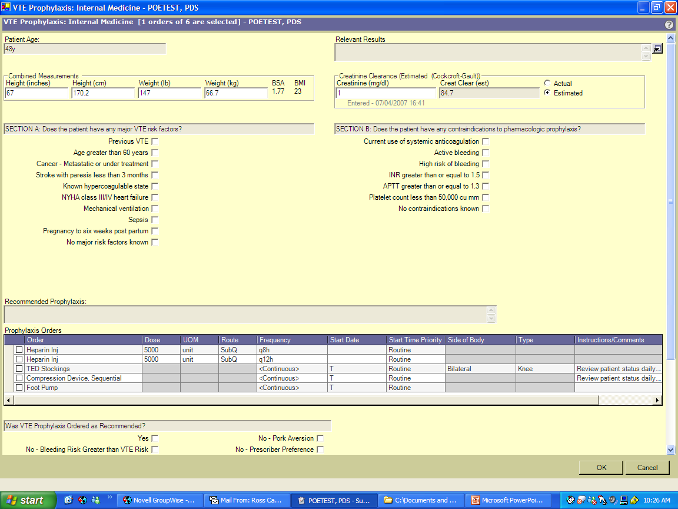
Patient age, weight, renal function and relevant labs imported from database
29

Slide 30
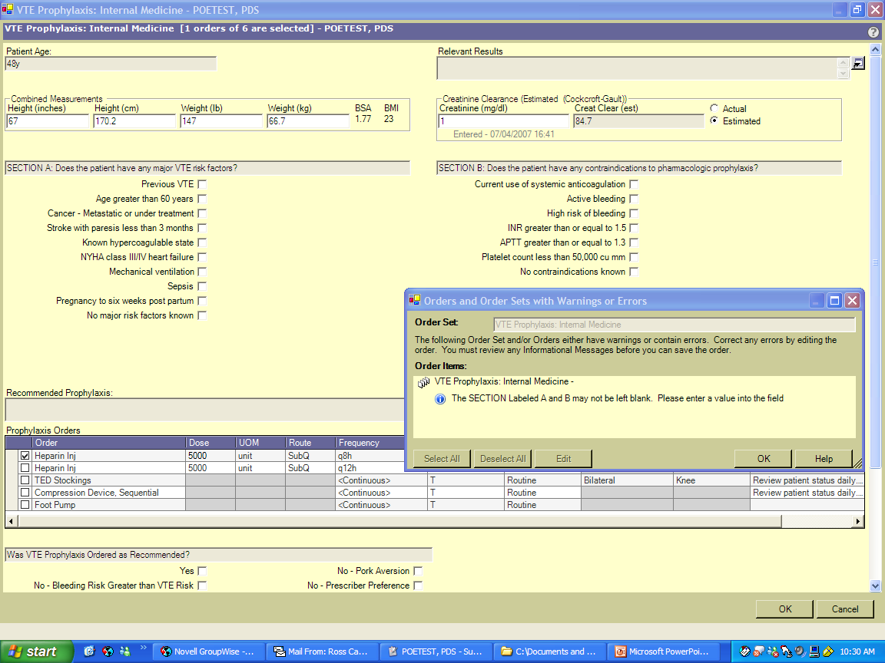
Mandatory Selections
  Risk Factors
  Contraindications
30

Slide 31
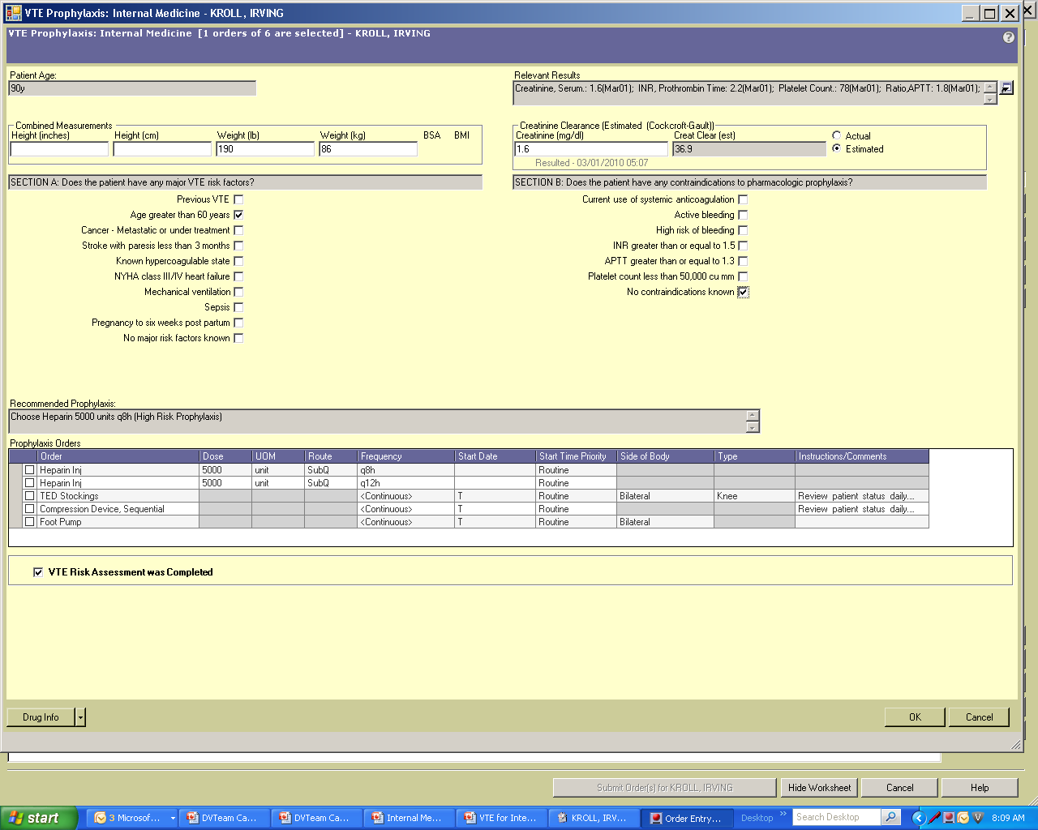
Prophylaxis Recommendation
31

Slide 32
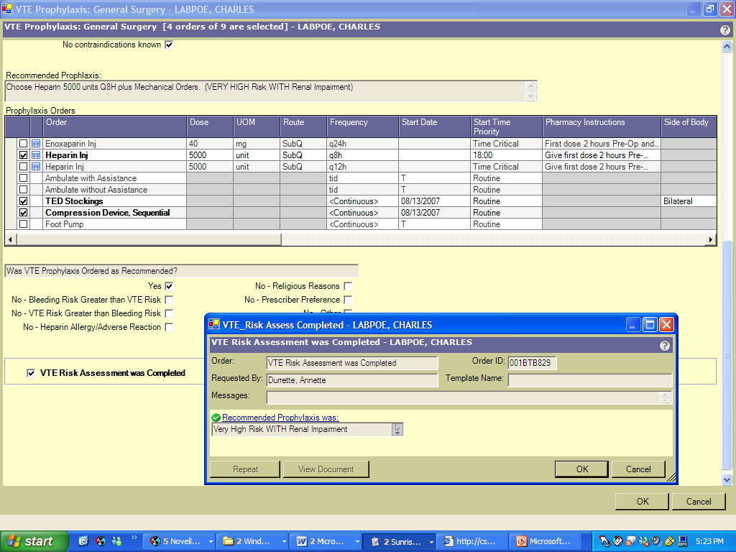
Documentation of Risk Assessment
32

Slide 33
TJC and SCIP Measures
Measures
Relatively low bar
Do not drive rapid cycle QI
Looks only at set points in hospitalization
  Does not address patients who “fall off” protocol
TJC measures: any prophylaxis = adequate prophylaxis
Go Beyond Core Measures to achieve better results
Judge adequacy of prophylaxis by adherence to your protocol
HA VTE = readmitted cases with new VTE + those not present on admission
Monitor for lapses in care on a day-to-day basis
33

Slide 34
Outcomes measure for HA VTE and Preventable VTE
Measures
Real time capture using imaging system, and concurrent review of cases to see if they are HA or community acquired, preventable / not preventable. Not practical for most, but may be gold standard.
Improved methodology using administrative data
  Captures readmitted patients as well as those with POA = No
  Captures UE DVT, but tracks them separately
  Higher bar for ‘preventable’
  Audits to validate coding
Administrative coding Caveats
34

Slide 35
Need to address all common failures in process
Key to success
No protocol / standardized order sets
Order sets / prompts for VTE P in place, but no guidance
Order sets with guidance in place but bypassed
Order sets with guidance in place and used, but used incorrectly
Patient gets placed on right prophylaxis, but VTE / bleeding risk changes and adjustment not made.
Prophylaxis gets missed / changed on transfer / peri-op setting
Correct prophylaxis ordered, but not administered, or patient refuses.
Patient not mobilized optimally
Preventable risk factors (central line) not optimally managed
Patient had indication for extended duration prophylaxis, but did not get it
35

Slide 36
Strategies for VTE Prevention
Beyond order sets
Good protocol driven order set is well integrated
Assessing administration / adherence
  (not just orders)
Alert Systems
  Electronic alerts (E-alerts)
  Human alerts
Raising situational awareness (eg checklists)
Audit and feedback
Measure-vention
Increase activity
Optimize central lines
Focus on extended duration for select populations
Notes:
36
a multifaceted approach
Variety of techniques
SHM collaborative
Audit/feedback. For true breakthrough levels of improvement, teams need to use education, standardized order sets, and a method to monitor prophylaxis rates, and act on those that are not on prophylaxis.
Kakkar AK, Davidson BL, Haas SK. Compliance with recommended
prophylaxis for venous thromboembolism: improving the use and rate of uptake of clinical practice guidelines. J Thromb Haemost. 2004;2:221–27.
Maynard G, Morris T, Jenkins I, Stone S, Lee J, Renvall M, Fink E, Schoenhaus R. Optimizing Prevention of Hospital-Acquired Venous Thromboembolism: Prospective Validation of a VTE Risk Assessment Model. Sep, J Hosp Med. 2009 early view
23. Maynard G, Stein J. Preventing Hospital-Acquired Venous Thromboembolism - A Guide for Effective Quality Improvement. Society of Hospital Medicine website, VTE Quality Improvement Resource Room. Available at: http://www.hospitalmedicine.org/ ResourceRoomRedesign/RR_VTE/VTE_Home.cfm. Last accessed July 14, 2009.
24. Maynard G, Stein J. Preventing Hospital-Acquired Venous Thromboembolism: A Guide for Effective Quality Improvement, version 3.3. Society of Hospital Medicine supplement, The Hospitalist August 2008, Vol 12 (8) 1-40.
25. Maynard G, Stein J. Preventing Hospital-Acquired Venous Thromboembolism: A Guide for Effective Quality Improvement. Prepared by the Society of Hospital Medicine. AHRQ Publication No. 08-0075. Rockville, MD:
32. Cohn SL, Adekile A, Mahabir V. Improved use of thromboprophylaxis for deep vein thrombosis following an educational intervention. J Hosp Med. 2006;1:331–338.
33. Stein J, Chernetsky Tejedor S, Shabbir H, O'Malley E. Situational Awareness Improves Prevalence of VTE Prophylaxis on Multiple Nursing Units. J Hosp Med. 2008: Vol 3(S1): 41.
34. Schunemann HJ, Cook D, Grimshaw J, et al. Antithrombotic and thrombolytic therapy: from evidence to application: the Seventh ACCP Conference on Antithrombotic and Thrombolytic Therapy. Chest 2004; 126:688S–696S
35. Tooher R, Middleton P, Pham C, et al. A systematic review of strategies to improve prophylaxis for venous thromboembolism in hospitals. Ann Surg 2005; 241:397–415.
36. Oxman AD, Thomson MA, Davis DA, Haynes RB. No magic bullets: a systematic review of 102 trials of interventions to improve professional practice. CMAJ 1995; 153:1423–1431.
37. Levi D, Kupfter Y, Seneviratne C, Tessler S. Computerized order entry sets and intensive education improve the rate of prophylaxis for deep vein thrombophlebitis. Chest 1998;114S:280S.
38. Dobesh PP, Stacy ZA. Effect of a clinical pharmacy education program on improvement in the quantity and quality of venous thromboembolism prophylaxis for medically ill patients. J Manag Care Pharm. 2005;11:755–762.
39. Timmons S, O’Callaghan C, O’Connor M, et al. Audit guided action can improve the compliance with thromboembolic prophylaxis prescribing to hospitalized, acutely ill
older adults. J Thromb Haemost 2005; 3:2112–2113
40. Mosen D, Elliott CG, Egger MJ, et al. The effect of a computerized reminder system on the prevention of postoperative venous thromboembolism. Chest 2004; 125:1635–
1641
41. Kucher N, Koo S, Quiroz R, et al. Electronic alerts to prevent venous thromboembolism among hospitalized patients. N Engl J Med 2005; 352:969–977.
42. Durieux P, Nizard R, Ravaud P, Mounier N, Lepage E. A clinical decision support system for prevention of venous thromboembolism. JAMA 2000;283:2816-2821.
43. Dexter PR, Perkins S, Overhage JM, Maharry K, Kohler RB, McDonald CJ. A
computerized reminder system to increase the use of preventive care for hospitalized
patients. N Engl J Med. 2001; 345:965-970.

Slide 37
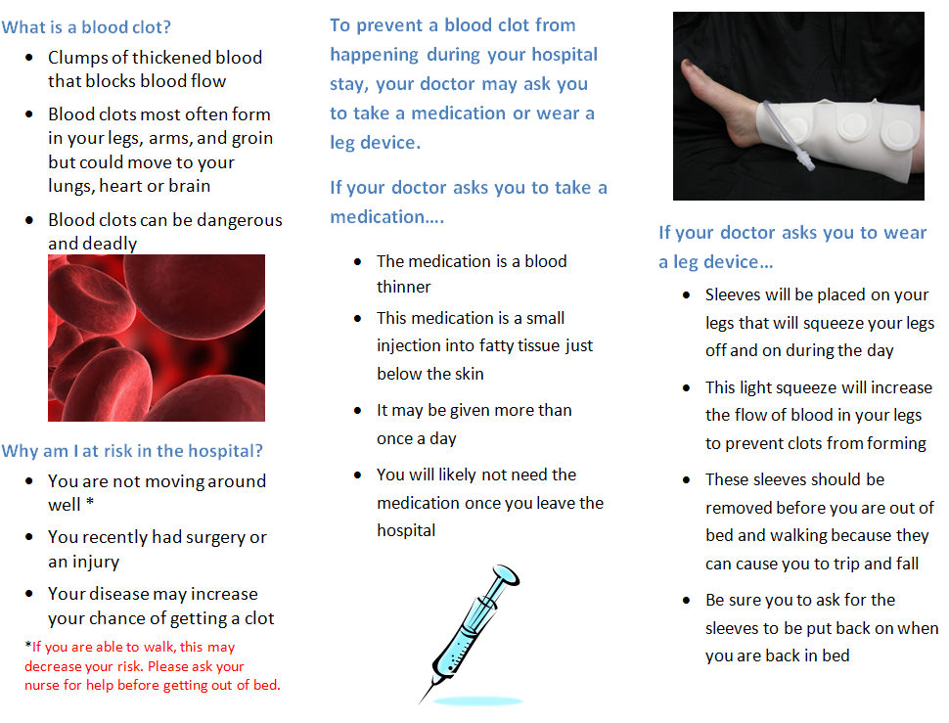
37

Slide 38
MEASURE-VENTION
Daily measurement drives concurrent intervention
(i.e., same as Level 5 in Hierarchy)
Identify suboptimal prophylaxis in real time
  Ongoing assessment
  Use for real-time intervention
38
Notes:
38
38

Slide 39
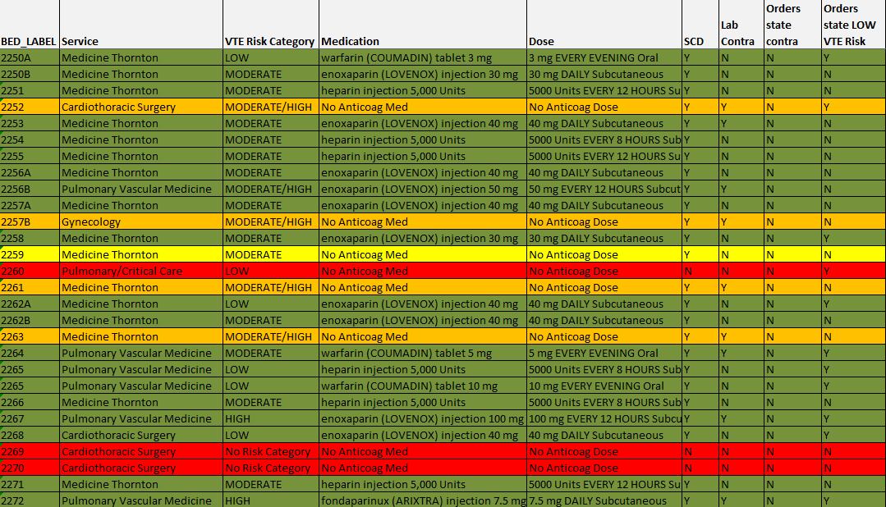
28 Patients – Measure-vention
20 on anticoagulation
4 on mechanical prophylaxis with lab contraindication
3 on Nothing 1 mechanical
39

Slide 40
Effect of Situational Awareness on Prevalence of VTE Prophylaxis by Nursing Unit
Hospital A, 1st Nursing Unit
Baseline Post-Intervention
UCL: 93% 104%
Mean: 73% 99% (p < 0.01)
LCL: 53% 93%
Hospital A, 2nd Nursing Unit
Baseline Post-Intervention
UCL: 90% 102%
Mean: 68% 87% (p < 0.01)
LCL: 46% 72%
Hospital B, 1st Nursing Unit
Baseline Post-Intervention
UCL: 89% 108%
Mean: 71% 98% (p < 0.01)
LCL: 53% 88%
Intervention
Hospital Days
Intervention
_______________________
UCL = Upper Control Limit
LCL = Lower Control Limit
40
40
Notes:
40
Work really exemplified by Stein work here

Slide 41
Patient Enemy #1: Bed
Complications Associated with Hospital Beds:
  Aspiration pneumonia
  Deep Vein Thrombosis
  Delirium
  Pulmonary Emboli
  Pressure Ulcers
  Ileus, Bowel Paralysis
41

Slide 42
PICC Lines
Increasing use
Symptomatic VTE associated with PICC during hospitalization 3.0 -7.8%
Significant CLABSI burden
Occlusion complications / lytics
42

Slide 43
Practices to Reduce PICC complications
Minimize exposure to PICCs
  Maximize midline / PIV
  Remove asap
Size matters – smaller PICCs = fewer DVT
Smallest number of lumens
Proper flushing
Following all infection control practices
Fewer attempts to place PICC
Appropriately sized catheter in proper position
Appropriate DVT prophylaxis probably helps some, but not as much as for leg DVT
Special catheters?
Evans RS, Sharp JH, Linford LH, Lloyd JF et al. Reduction of Peripherally Inserted Central Catheter-Associated DVT. Chest 2013; 143(3):626-633.
Mai C, Hunt D. Upper-extremity Deep Vein Thrombosis: A Review. Am J Med 2011; 124:402-407.
43

Slide 44
Questions / Answers / Comments?
Coming Spring 2015 - Major Revision / Update AHRQ DVT Prevention Guide
Questions on this webinar series? Contact Cynthia Sayers at 404-498-0020.
44

